Slide 1
Insurance Cost Prediction
Using Machine Learning to Predict Insurance Costs
Sreyashree Pati

Slide 2
Introduction
Overview of the project
Objective: Predict insurance costs based on various factors using machine learning

Slide 3
Dataset
Description of the dataset
Key features used for prediction:
- Age
- Sex
- BMI
- Children
- Smoker
- Region
- Charges

Slide 4
Data Preprocessing
Steps for cleaning and preparing the data:
- Handling missing values
Used for improved data quality, model performance, and to ensure whether the dataset is suitable for analysis and modelling.
- Encoding categorical variables
It helps to reduce dimensionality of categorical variables with many levels, and to get improved model quality.
- Scaling numerical features
Reduces numerical instability. Properly scaled features lead to more accurate, stable, and reliable models.

Slide 5
Exploratory Data Analysis (EDA)
Visualization of key features:
- Distribution of age, BMI, and charges
- Charges vs. smoker status
- Charges vs. number of children
Insights drawn from the data:
- Smokers have higher insurance costs
- Higher BMI tends to increase insurance costs

Slide 6
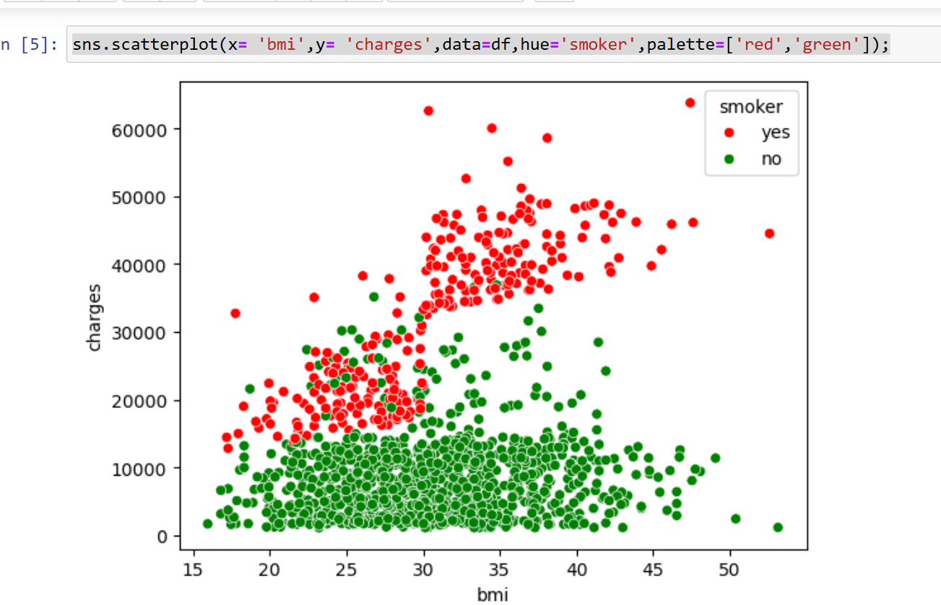
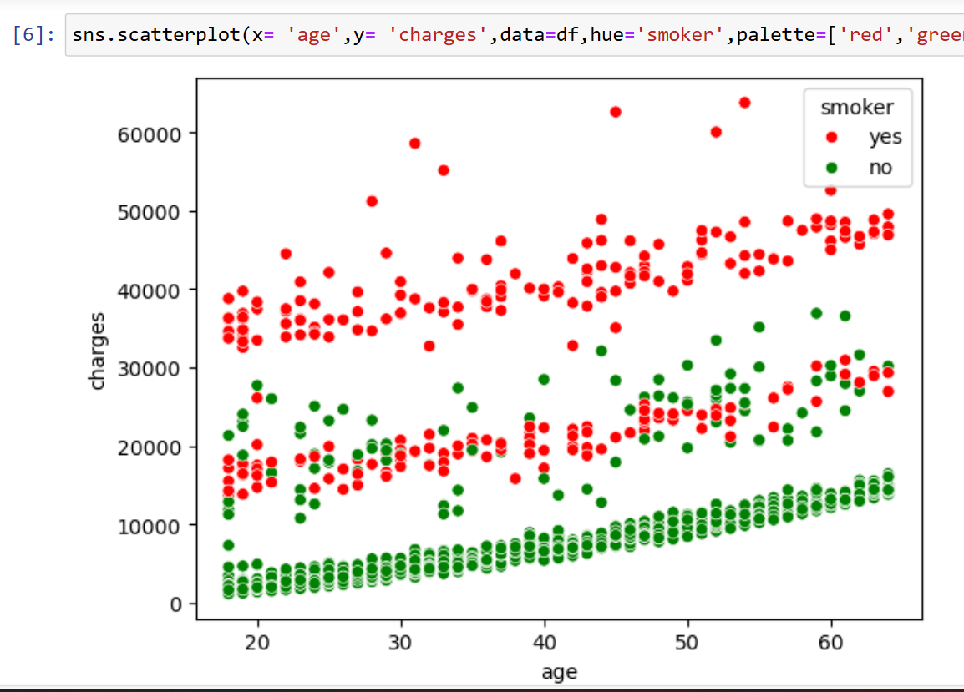

Slide 7
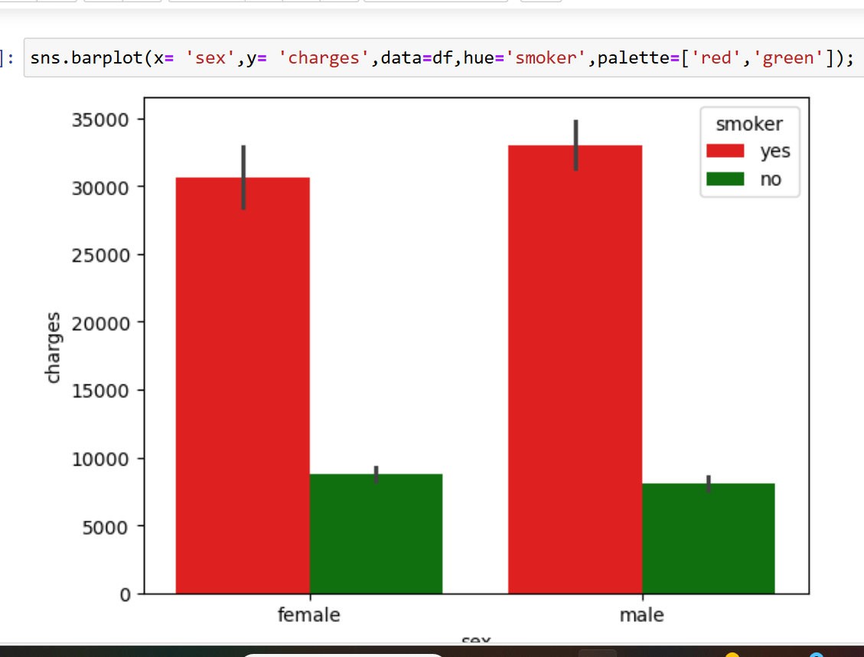
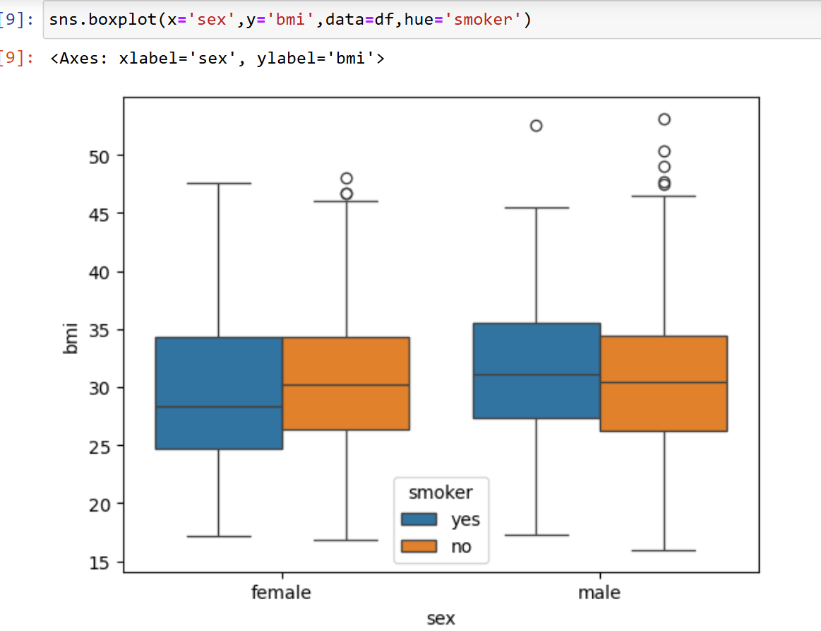
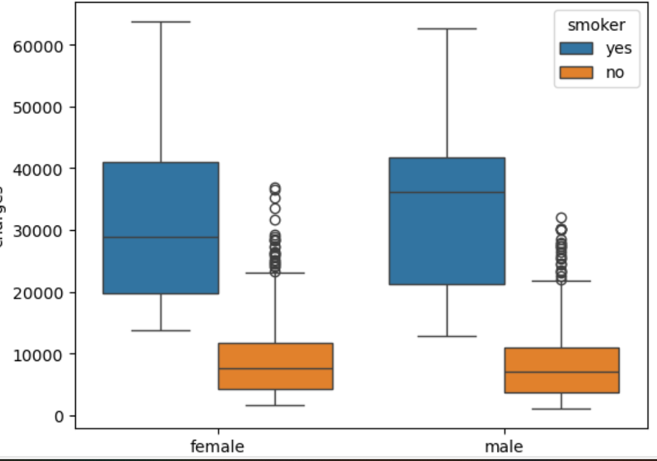

Slide 8
Feature Engineering
Creation of new features
Selection of important features for the model:
- Age
- BMI
- Children
- Smoker
- Region

Slide 9
Model Selection
Comparison of different models:
- Linear Regression
Relationship between dependent and independent variable.
- Decision Tree Regressor
- Random Forest Regressor
- Gradient Boosting Regressor
Selection criteria for the final model:
- Performance on validation data
- Model complexity and interpretability

Slide 10
Model Training
Description of the chosen model (Gradient Boosting Regressor)
Hyperparameters and training process:
- Learning rate
- Number of estimators
- Maximum depth

Slide 11
Model Evaluation
Metrics used for evaluating the model:
- Mean Absolute Error (MAE)
- Mean Squared Error (MSE)
- R-squared
Performance of the model on test data
MAE: 4250.066214239165
MSE: 37743576.51995749
RMSE: 6143.580106091032

Slide 12
Conclusion
Summary of findings:
- Gradient Boosting Regressor provides accurate predictions for insurance costs
Future work and potential improvements:
- Explore additional features
- Tune hyperparameters further
- Use other advanced models

